Slide 1
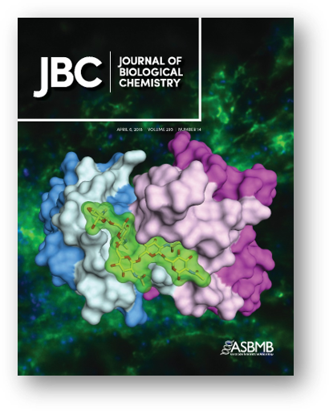
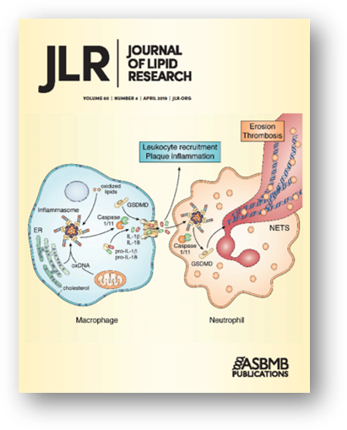
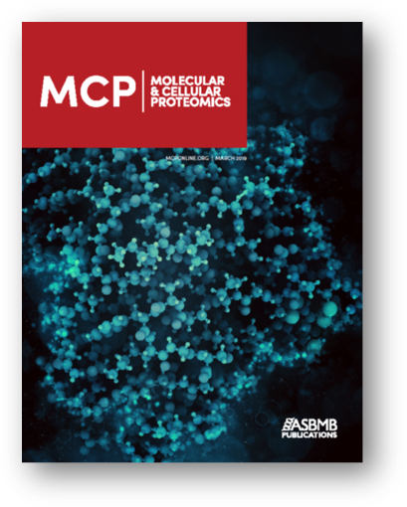
Advocate for Science & Society:
ASBMB supports the next generation of scientists by working with federal policymakers and science-related agencies to address emerging issues through:
Pro-science legislation
Increased funding for biomedical research
Promoting inclusivity and international collaboration
Advocacy training
Outreach funding
Awards and scholarships
Research Publication & Education:
Three major, peer-reviewed journals publishing rigorous, high-quality research findings
Monthly magazine updating members on developments and trends in BMB, investigative reports, and personal essays from science professionals & students
ASBMB program accreditation and student proficiency exams ensuring continuity between academics & professional science
Extensive catalog of seminars and lectures available online
A UNM Chartered Student Organization founded to help BMB undergraduates:
Connect outside the classroom to share experiences, get advice, and gain leveraged access to opportunities,
Plan and build successful futures in BMB.
Serve the campus and community through educational and volunteering events,
Develop presentation, organization, and leadership skills.
Access professional resources through membership in the national ASBMB→
Career Development & Professional Networking:
Live workshops and on-demand content cover post-graduate study & job market preparation, including mentorship, CVs & resumes, communication & presentation skills, and research & publication processes.
In-person & virtual conferences, and a hosting platform for custom event creation, provide unlimited opportunities to connect regionally & nationally with peers & professionals, learn about cutting edge research in progress, and present their own work.
Current job postings, summer internship locators, and virtual career fair listings exponentiate opportunity.
No Membership Fee for Biochemistry Program Undergraduates
Contact us:
ASBMB@UNM
Faculty Advisors:
Laura de Lorenzo - Undergraduate Director
Curt Hines - Undergraduate Honors Director
The American Society for Biochemistry and Molecular Biology is an international nonprofit scientific & educational organization made up of molecular life science students, researchers, educators and industry professionals
Notes:
Use the QR code to join today!
Membership fees: regular/industry ($160), early career ($70), graduate ($25), undergrad ($10), affiliate (45), student chapters

